Slide 1

Customer Churn Analysis using Tableau
PRESENTED BY:
Rajat Bahuguna

Slide 2

Company Overview
Challenges and Objectives
Agenda
Methodology
Data Cleaning & Joining
Analysis & Insights
Recommendations
Get in Touch

Slide 3

Company Overview
TeleWave Communications is a fictional telco company that provided home phone and Internet services to 7043 customers in California.
Back to Agenda

Slide 4
Dataset
The dataset of customer churn data contains information of these 7043 customers in California in Q3 such as which customers have left, stayed, or signed up for their service. Multiple important demographics are included for each customer, as well as a Satisfaction Score, Churn Score, and Customer Lifetime Value (CLTV) index.
Back to Agenda

Slide 5

Problem Statement
TeleWave Communications experienced a high churn rate of 26.54% in Q3 and seeks to identify the underlying factors contributing to this issue. A comprehensive analysis is required to uncover key drivers of customer attrition, provide actionable insights and recommendations to reduce churn and improve customer retention.
Back to Agenda

Slide 6

Challenges
and Objectives
Back to Agenda
Objectives
Design an Exploratory Dashboard which summarises all key insights.
Build individual visualisations to depict depper insights.
Recommendations to decrease overall churn rate.
Challenges
Identify underlying reasons for churn rate, build dashboard to present insights.
Come up with recommendations to decreases this churn and improve customer retention.

Slide 7

Methodology
Back to Agenda
01
02
03
Data Cleaning & Joining
Analysis & Insights
Recommendations
Showcase key insights observed during data analysis of cleaned data.
Based on our insights, come up with recommendations to decrease churn rate.
Perform data cleaning to remove errors and join all tables to get final dataset.

Slide 8


01
Data Cleaning & Joining
Back to Agenda
This step involves removing errors, inconsistencies, missing data and other steps to ensure clean data for data analysis.
We will using MS Excel to perform data cleaning and then join our data in SQL to obtain final cleaned dataset for further analysis.

Slide 9



Data Cleaning
Back to Agenda
Imputed missing values in `Churn Reason` & `Churn Category` column of `Status` table with `Not Applicable` as missing values were only in the customers who did not churn.
Ensured data to be complete (with no missing values), accurate (looked for inconsistencies and removed them if available) and removed unnecessary columns which do not add any value to table.
Finally, merged all the tables as left joined all tables as (on common field “Customer ID”):
services - - - > status - - -> demographics - - -> location - - -> population

Slide 10

02
Analysis & Insights
Back to Agenda
This step involves Univariate, Bivariate and Multivariate analysis of variables and drawing insights in Tableau.
Apart from building visualisations, a dynamic dashboard would also be added.
This analysis is further divided into following three parts:
Overview
Customer Analysis
Service Analysis

Slide 11


Slide 12
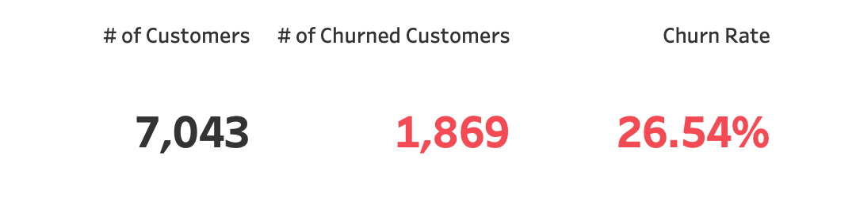
Overall Customers & Churn Rate
Back to Agenda
High churn rate of 26.54% was observed during third quarter overall.
Out of 7043 total customers, 1869 (26.54%) have stopped using services offered by TeleWave and are not customers anymore.
Customers and Churn Rate

Slide 13
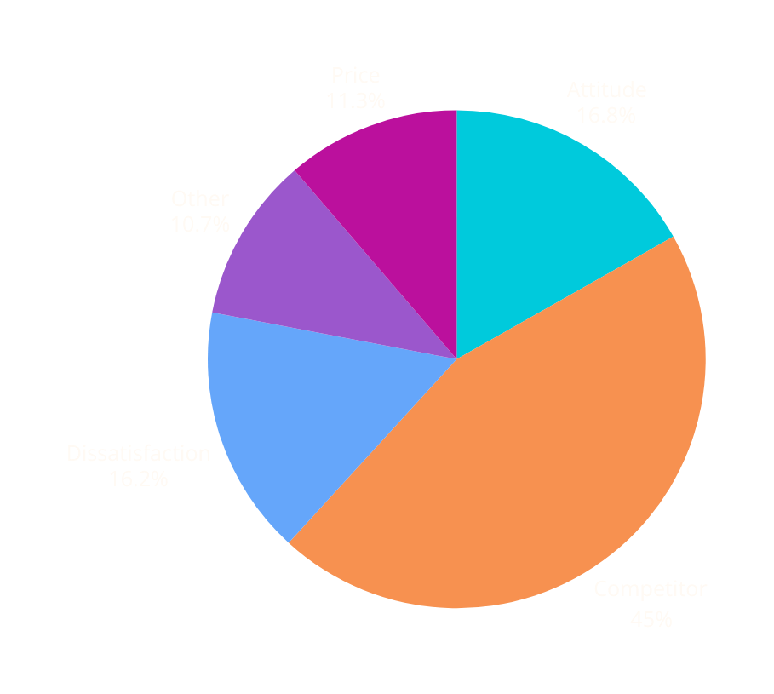
Churn Category
Back to Agenda
Competitor is a major reason for nearly half of churned customers.
Competitor (45%), Attitude (17%) and Dissatisfaction (16%) are the most popular categories for customer churning.
Churn by category
Let us look deeper into each category to understand better...

Slide 14


Competitor (Subcategory)
Back to Agenda
Competitor had better devices and made better offers
Competitor is offering better devices, better offers, more data, and higher download speeds

Slide 15
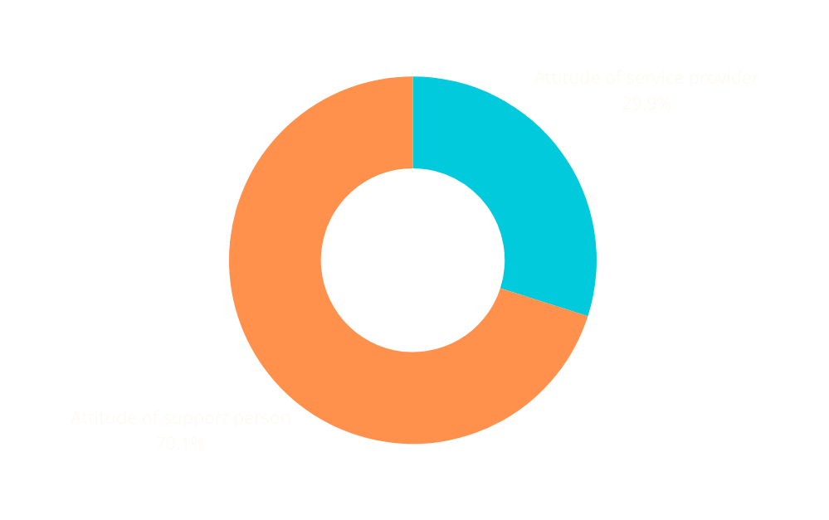
Attitude (Subcategory)
Back to Agenda
Attitude of support person is a major concern.
Roughly 17% of churned customers have attitude as reason to churn.
Digging deeper support person (70%) and service provider (30%) attitudes are leading to more customers dropping.
Attitude Subcategory

Slide 16
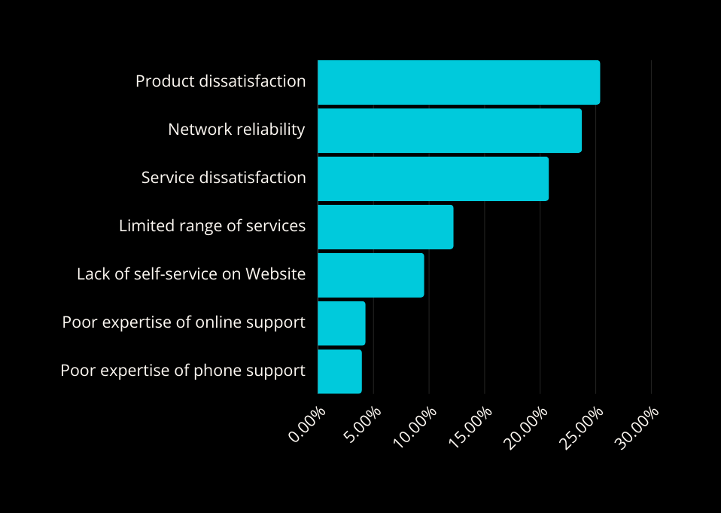
Dissatisfaction (Subcategory)
Back to Agenda
Product, Network Reliability and Service Dissatisfaction are big reasons for customers getting dissatisfied and churning.
Dissatisfaction with basic facilities as well as limited range of devices, poor website interface and poor customer support are leading to overall dissatisfaction amongst customers.
Dissatisfaction Subcategory

Slide 17

Price
(Subcategory)
Back to Agenda
Prices being too high, long distance charges along with extra data charges are also reason for customers churn.
Not only the customers who churned dissatisfied with the services, other churned customers are getting overcharged with compromised quality.
Price Subcategory
From the company’s end in terms of services, Attitude and Dissatisfaction are major red flags for churning. These are service issues and can be worked upon by the company.

Slide 18

Customer Analysis
In this step, we are going to look into our customer and their overall demography. This would help us in understanding our customer better, identify churn trends and develop strategies to decease it.

Slide 19
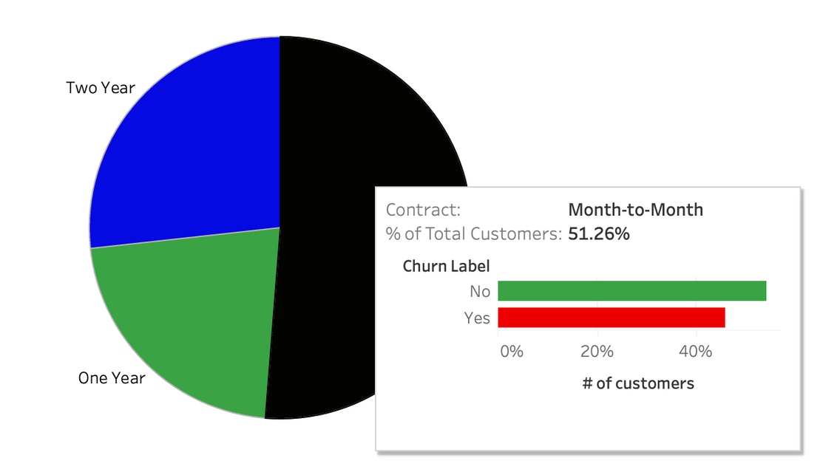
Churn by Contract
Back to Agenda
Month-to-Month contract customers with 46% churn rate
Month-to-Month customers comprise 51% of the customers overall.
In Contract, One Year and Two Year contract customers have significantly lower churn rate (11% and 3% respectively)
Month-to-Month churn

Slide 20

Senior vs Churn
Back to Agenda
Senior customers are twice as likely to churn.
Customers over 65 (Senior) have nearly double the churn rate than the ones who are below 65 (Senior = 42%, Non Senior = 24%)
Senior vs Churn Rate

Slide 21

Married vs Churn
Back to Agenda
Married customers are less likely to churn.
Married customers have significantly lower churn rate (nearly 20%) than unmarried customers (roughly 33%).
Married vs Churn

Slide 22

Dependents vs Churn
Back to Agenda
Customers with no dependents are four times more likely to churn
Customers with dependents have significantly lower churn rate (nearly 7%) than independent customers (roughly 33%).
Married vs Churn

Slide 23
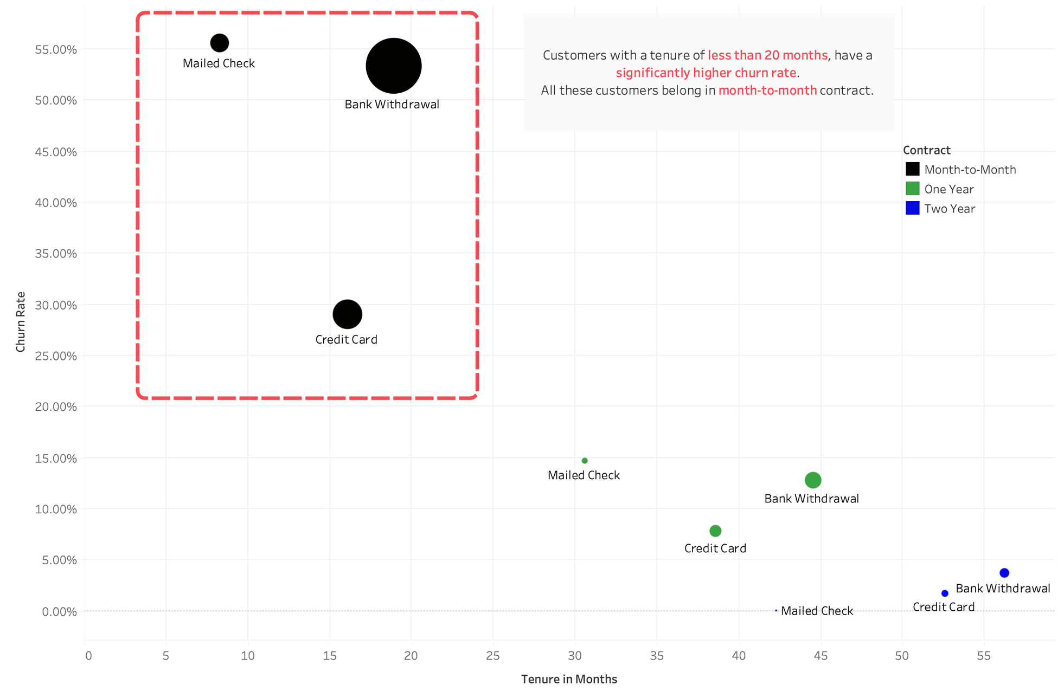
Tenure, Payment Method, Contract vs Churn Rate

Slide 24

Insights?
Recent Customers with Shorter Tenure Churn Due to Competitors and Poor Support, While Long-Term Users Churn Less
Customers with Average Tenure (in months) nearly 20 months (or roughly two years) which means these are customers which started using company services only recently, have churned. And these are all month-to-month contract users.
Their major reason is competitor offering better devices and better offers (external reasons) and attitude of support person (internal reason) as a major reason to churn.
There is a significantly lower churn rate in customers with average tenure over 20 months (churn rate nearly halves) and their churn reason is either Competitor or Product Dissatis- faction.

Slide 25

Service Analysis
In this step, we are going to look deeper into services offered by TeleWave Communications and its effect on overall churn. This would help us in identifying faulty services and issues from company’s end which are leading to customer churn.

Slide 26

Unlimited Data
Back to Agenda
Customers with unlimited data are twice as likely to churn compared to ones with no unlimited data
Customers with Unlimited Data have a churn rate 32% compared to ones with no unlimited data 16%
Unlimited Data vs Churn rate

Slide 27
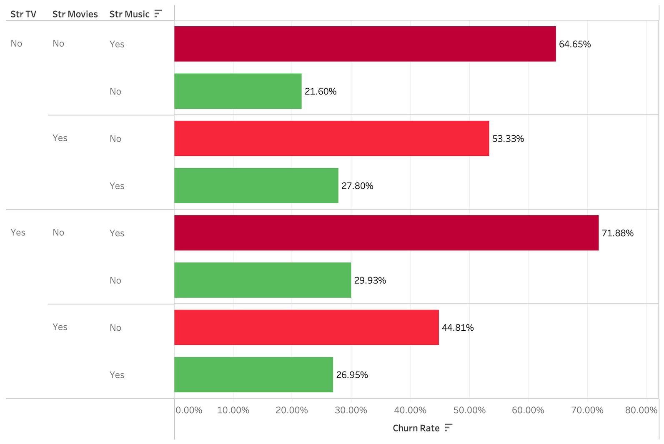
Streaming Services vs Churn
It can be clearly seen that there are many
red markers indicating high churn rates
Streaming Services with Churn Rates

Slide 28
Insights?
TeleWave has very poor music and movie streaming services
Regardless of customer having using a streaming TV (Str TV), if they use internet service for streaming music, their churn rate is very high (more than 60%). If they use the services for streaming movies, then too their churn rate is very high (more than 40%)
Similar is true for streaming only Music customers (churn rate is above 60%)

Slide 29
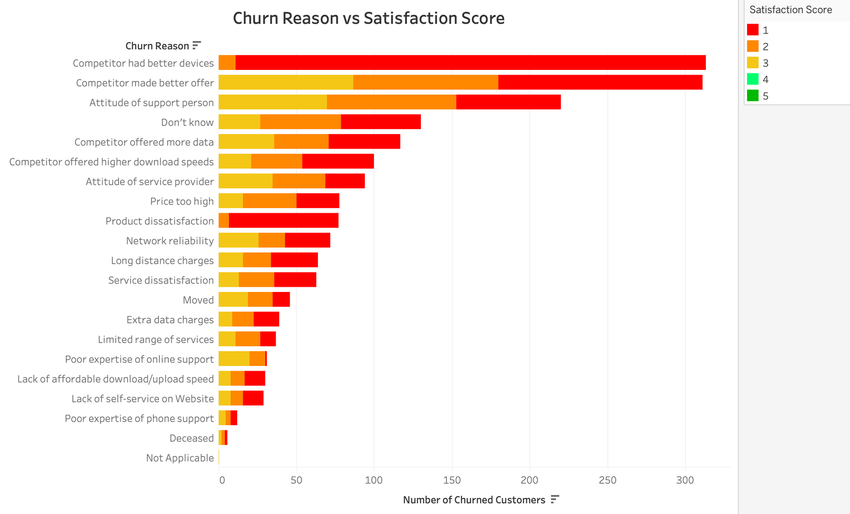
Churn Reason vs Satisfaction Score
Customers have given very low satisfaction scores overall
Churn Reason & Satisfaction Scores

Slide 30
Insights?
TeleWave’s devices (such as modems) are problematic and have been giving poor experience to the customers
Of the customers that left, their Satisfaction Scores are all 1 or 2 for Churn Reason = Competitor had better devices and Product dissatisfaction.

Slide 31
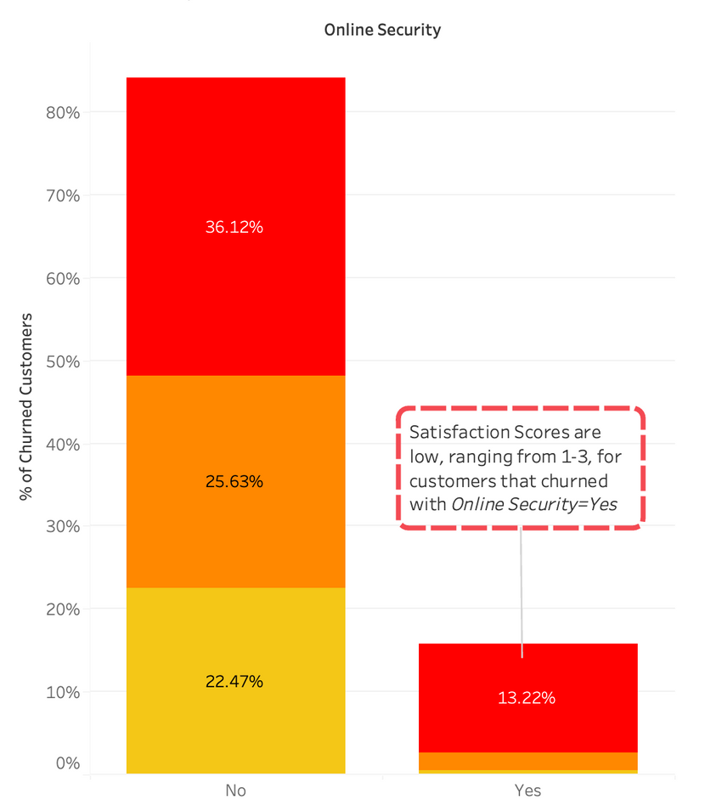
Online Security Services
Back to Agenda
Customers give very low satisfaction score to company’s online security services
Customers with Online Security feature have given low satisfaction score, i.e., 1, clearly indicating that the company’s online security services is bad.
Online Security vs Satisfactiion

Slide 32
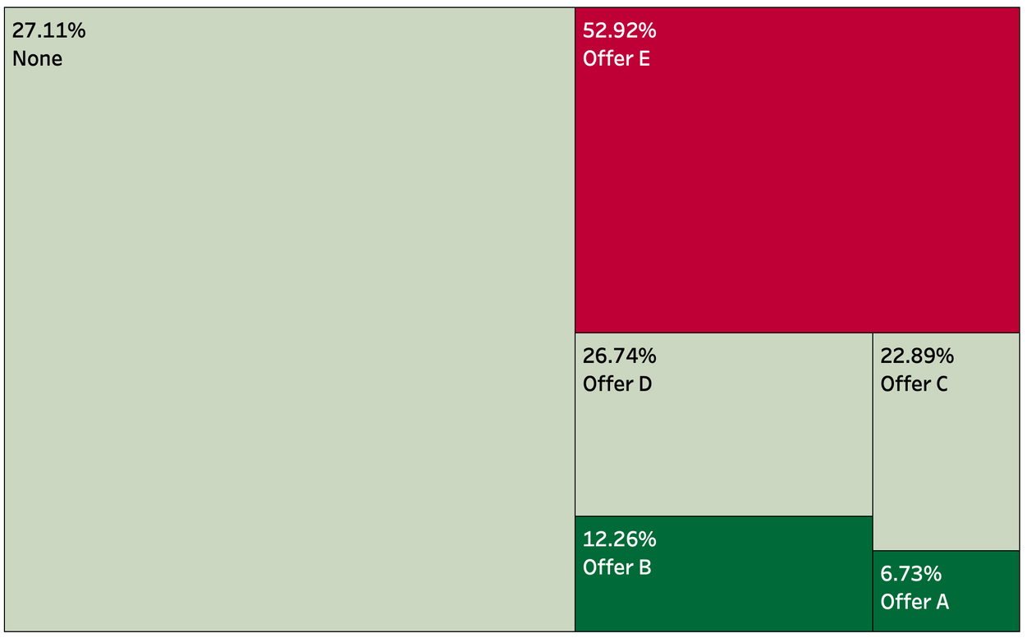
Offer vs Churn Rate
Back to Agenda
Customers with offer A have lowest churn rate
Size of the quadrant depicts total number of churned customers.
Customers with offer E have highest churn rate (~53%).
Customers with offer A have lowest churn rate (~7%)
Offers vs Churn Rate

Slide 33
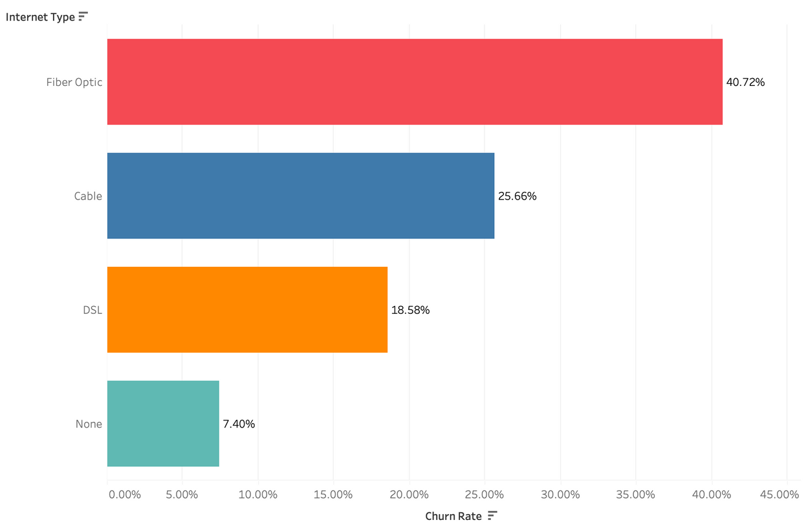
Internet Type vs Churn
Back to Agenda
Fiber Optic has highest churn rate
Majority of churned customers (nearly 40%) had fiber optic as their internet type followed by Cable (26%) and DSL (19%).
Internet Type vs Churn Rate

Slide 34
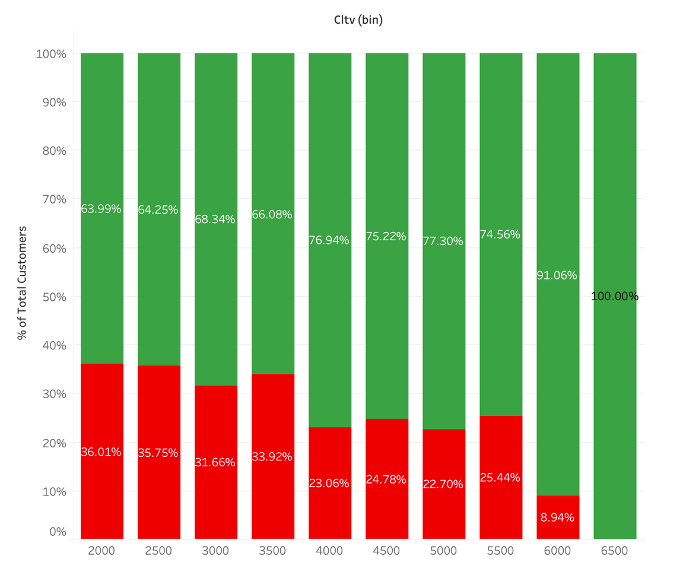
CLTV vs Churn
Back to Agenda
Customers with lower CLTV (≤ 3500) have higher churn rate than the above 3500 CLTV
Customers with lower lifetime value are more likely to churn when compared to high value customers (> 3500)
CLTV vs Churn Rate

Slide 35
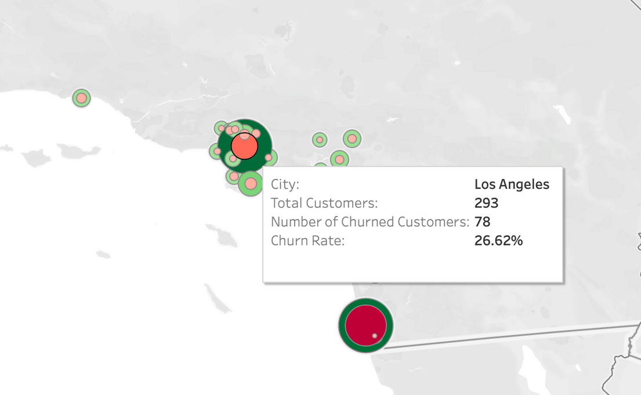
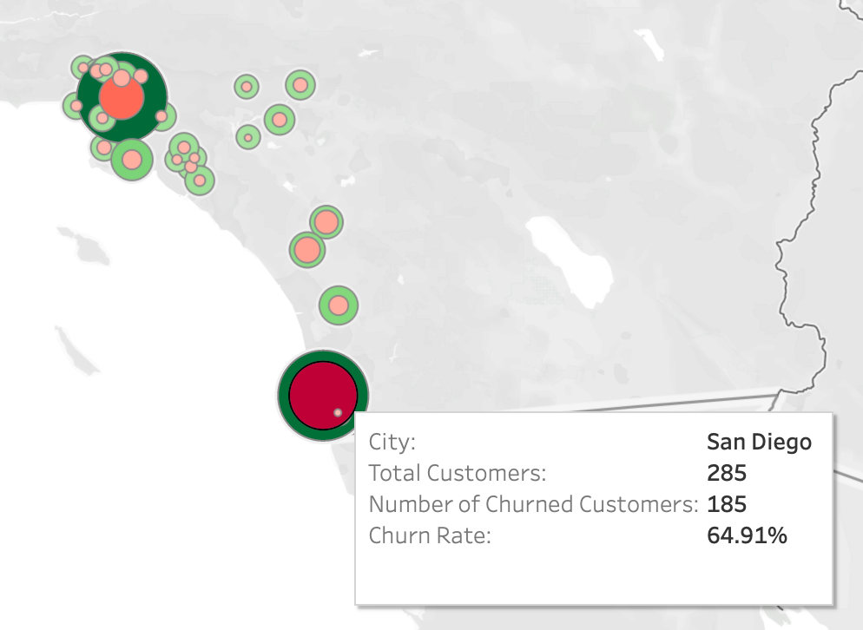
Cities vs Customer Churn
Back to Agenda
Los Angeles
San Diego
San Diego has the highest churn rate (65%)
Los Angeles has the highest number of customers, followed by San Diego.
All the other cities have a churn rate nearly around the overall churn rate.
A competitor has entered these cities where the company has many customers, and already started to offer better devices and offers, which are a major reason for customers to churn in these cities.

Slide 36
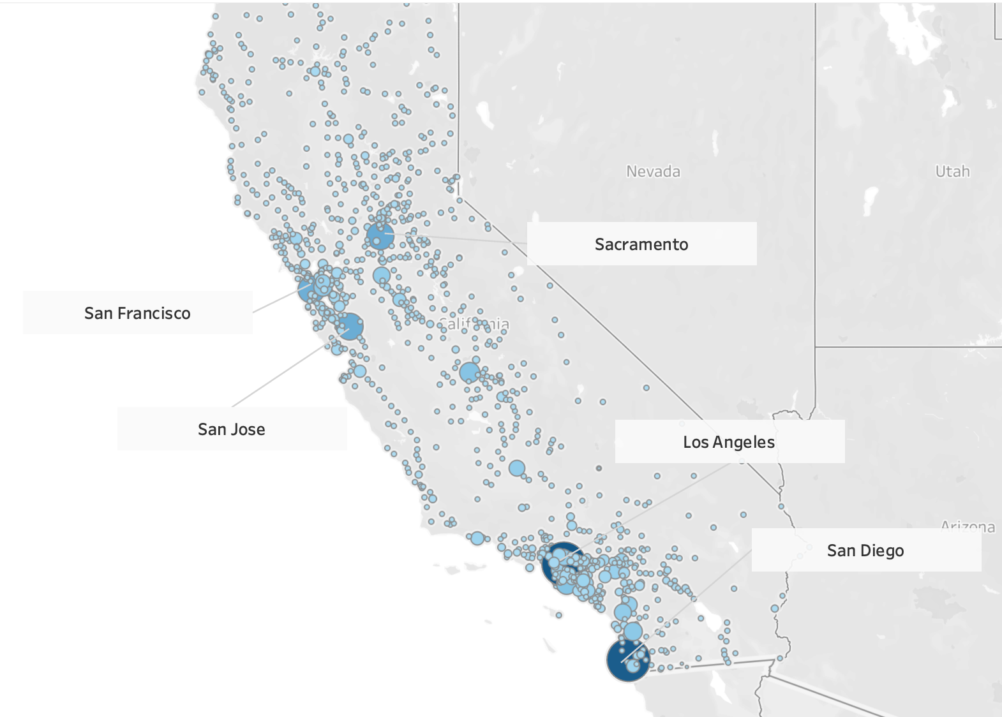
CLTV vs City

Slide 37
Insights?
Los Angeles and San Diego has highest overall CLTV (sum) in all cities
Los Angeles followed by San Diego, Sacramento, San Jose and San Francisco, are the cities where the highest overall customer value comes from.
Thus, if company decides to make changes and launch their retention campaign, these places would be ideal.

Slide 38
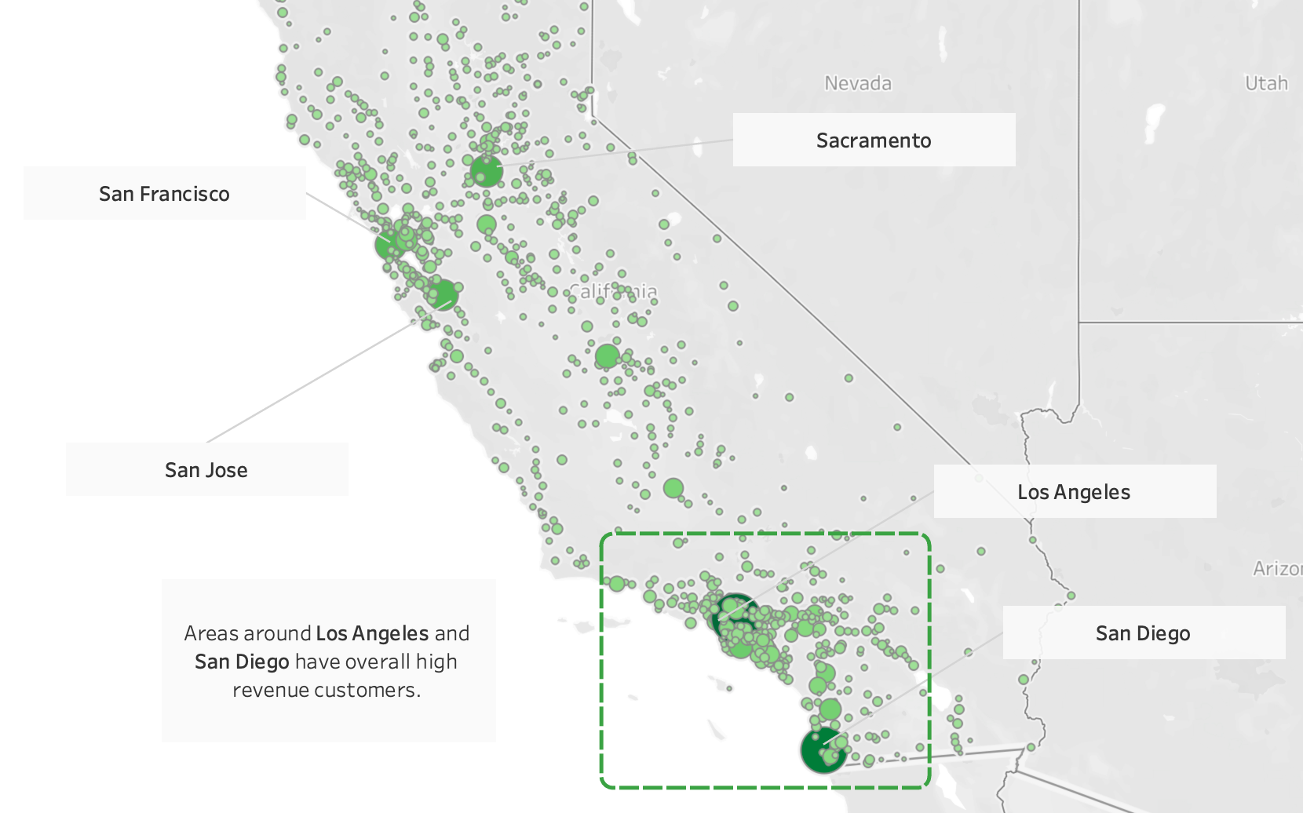
Revenue vs City

Slide 39
Insights?
Los Angeles and San Diego has highest overall revenue in all cities
Los Angeles followed by San Diego, Sacramento, San Jose and San Francisco, are the cities where the highest overall revenue comes from.
Also, areas around LA and San Diego are high revenue areas, so campaigning must be done in these areas first.

Slide 40

Recommendations
03
Back to Agenda
Better Offers and Devices
Conduct market research to understand competitors’ offerings and devices. Introduce competitive pricing, better data plans, and technologically advanced devices to match or surpass competitors’ offerings.
Enhance Streaming Quality
Invest in improving the quality and reliability of streaming services for music and movies. Ensure high bandwidth and minimal buffering for a better customer experience.
Attitude Issues
Invest in training programs for customer support representatives to improve their attitude and interaction quality with customers. Implement regular feedback mechanisms to monitor and enhance service quality.
Promotional Campaigns
Launch targeted promotional campaigns in high churn areas (e.g., San Diego) emphasizing the improved value and benefits of your services compared to competitors.
Senior-Friendly Services
Design and promote services that cater specifically to the needs of senior customers, such as simplified plans, senior discounts, and dedicated customer support for seniors.
Encourage Longer Contracts
Provide incentives for customers to switch from month-to- month contracts to one-year or two-year contracts. Offer discounts, additional services, or exclusive deals to long-term contract customers.

Slide 41
Continued...
Back to Agenda
Device Upgrades
Address the issues with current devices by investing in better quality modems and other hardware. Ensure that new devices meet high performance and reliability standards.
Tailored Marketing
Create marketing campaigns that appeal specifically to customers without dependents, highlighting features and benefits that resonate with their lifestyle and needs.
Expand Offer A
Given that customers with Offer A have the lowest churn rate, expand this offer to a broader customer base. Tailor similar attractive offers to different customer segments based on their usage patterns and preferences.
Local Marketing Efforts
Concentrate marketing efforts and resources on high-value cities like Los Angeles, San Diego, Sacramento, San Jose, and San Francisco. This can include localized advertising, sponsorships, and community events.
Address Fiber Optic Issues
Since a significant portion of churned customers used fiber optic internet, investigate and resolve any underlying issues with fiber optic services. Ensure consistent high-speed internet and minimal service interruptions.
Contract Offers
Given the lower churn rate among one-year and two-year contract customers, create attractive offers for month-to-month customers to switch to longer-term con- tracts. This can include discounted rates, additional features, and loyalty rewards.

Slide 42
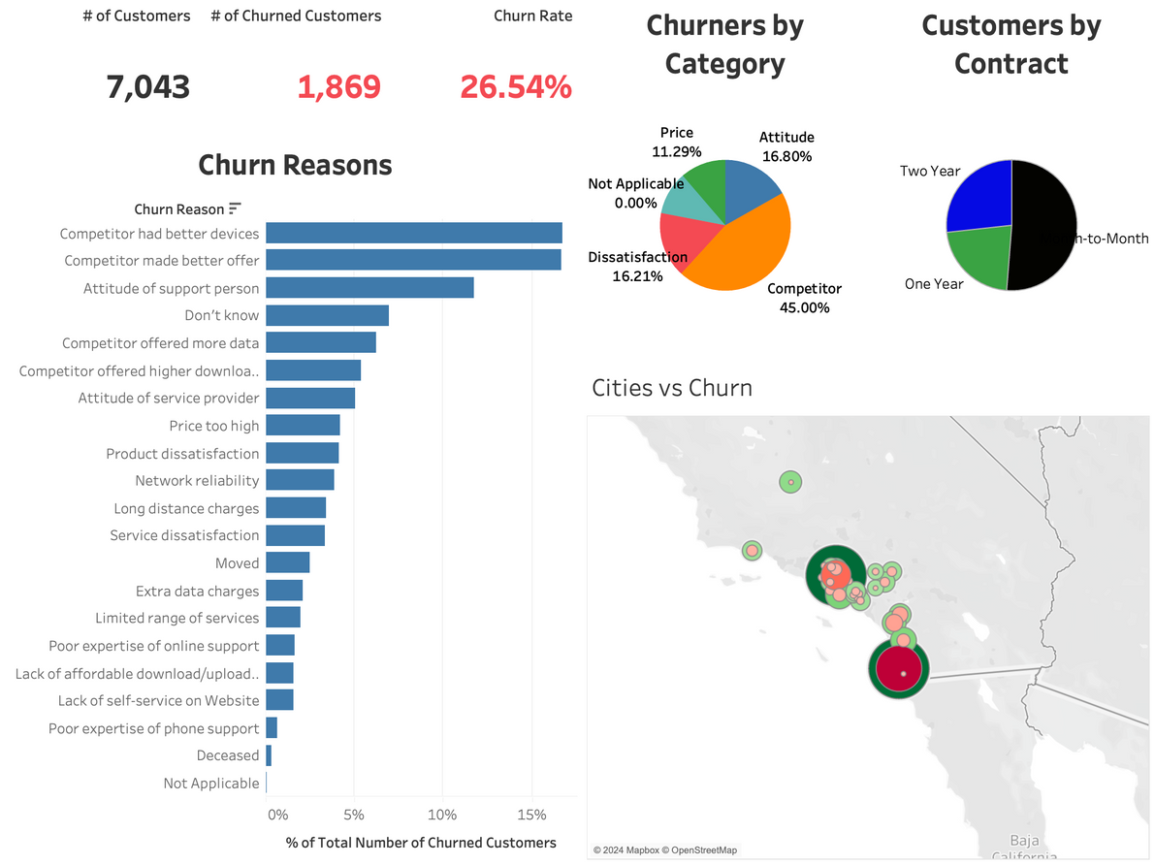
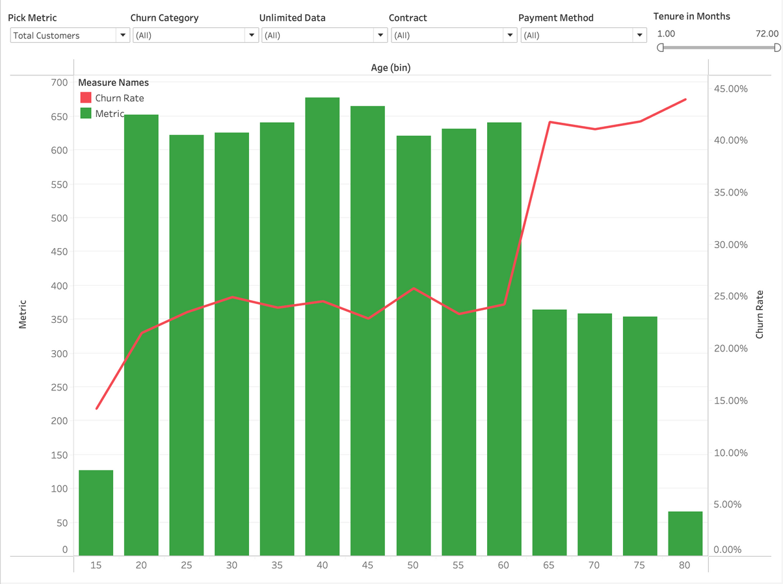
Dashboard Snaps
Back to Agenda
Overview
Age Brackets

Slide 43
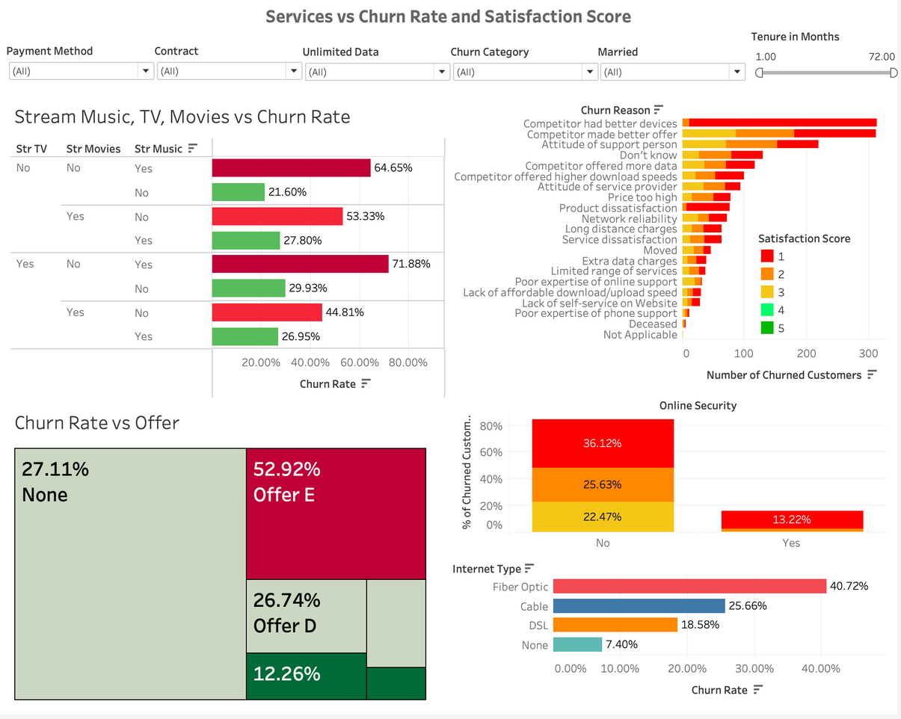
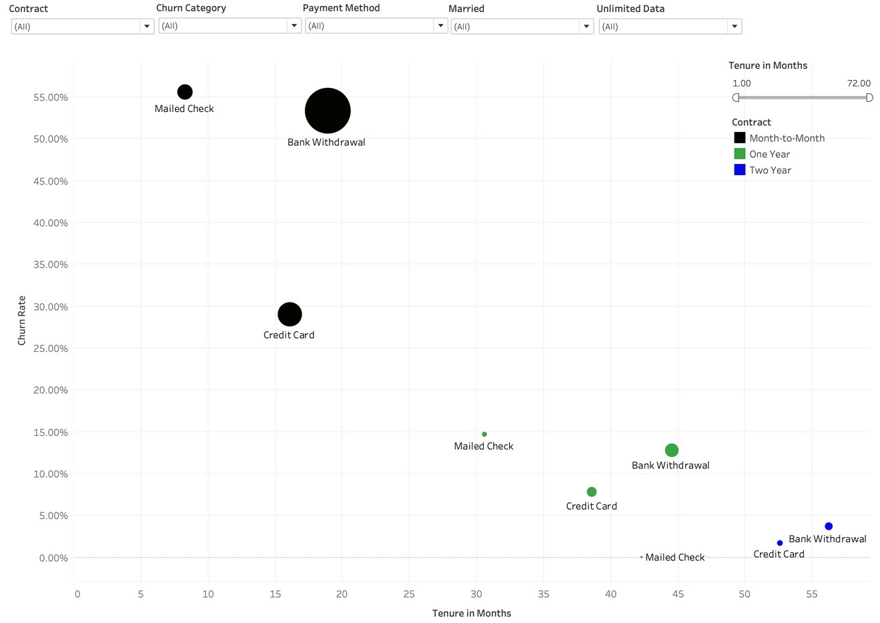
Continued...
Back to Agenda
Services vs Churn
Payment Method & Contract Type

Slide 44


Slide 45

Back to Agenda
Get In Touch
Email
Rajatbahuguna4445@gmail.com

